Slide 1
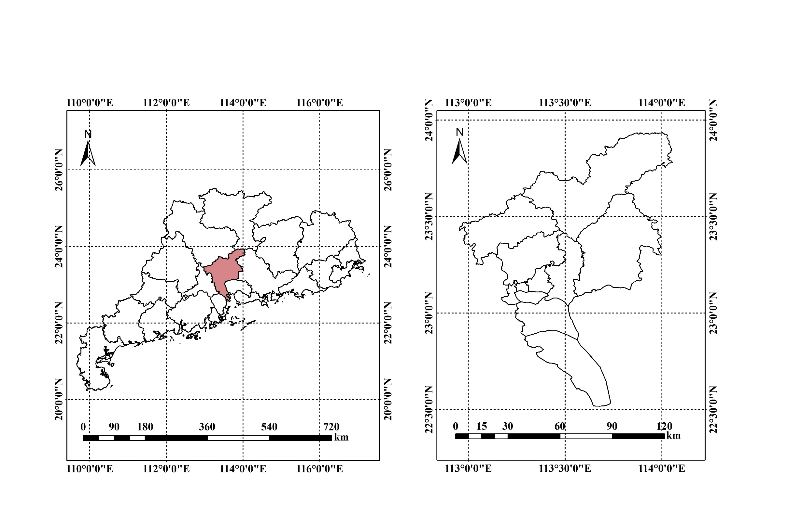
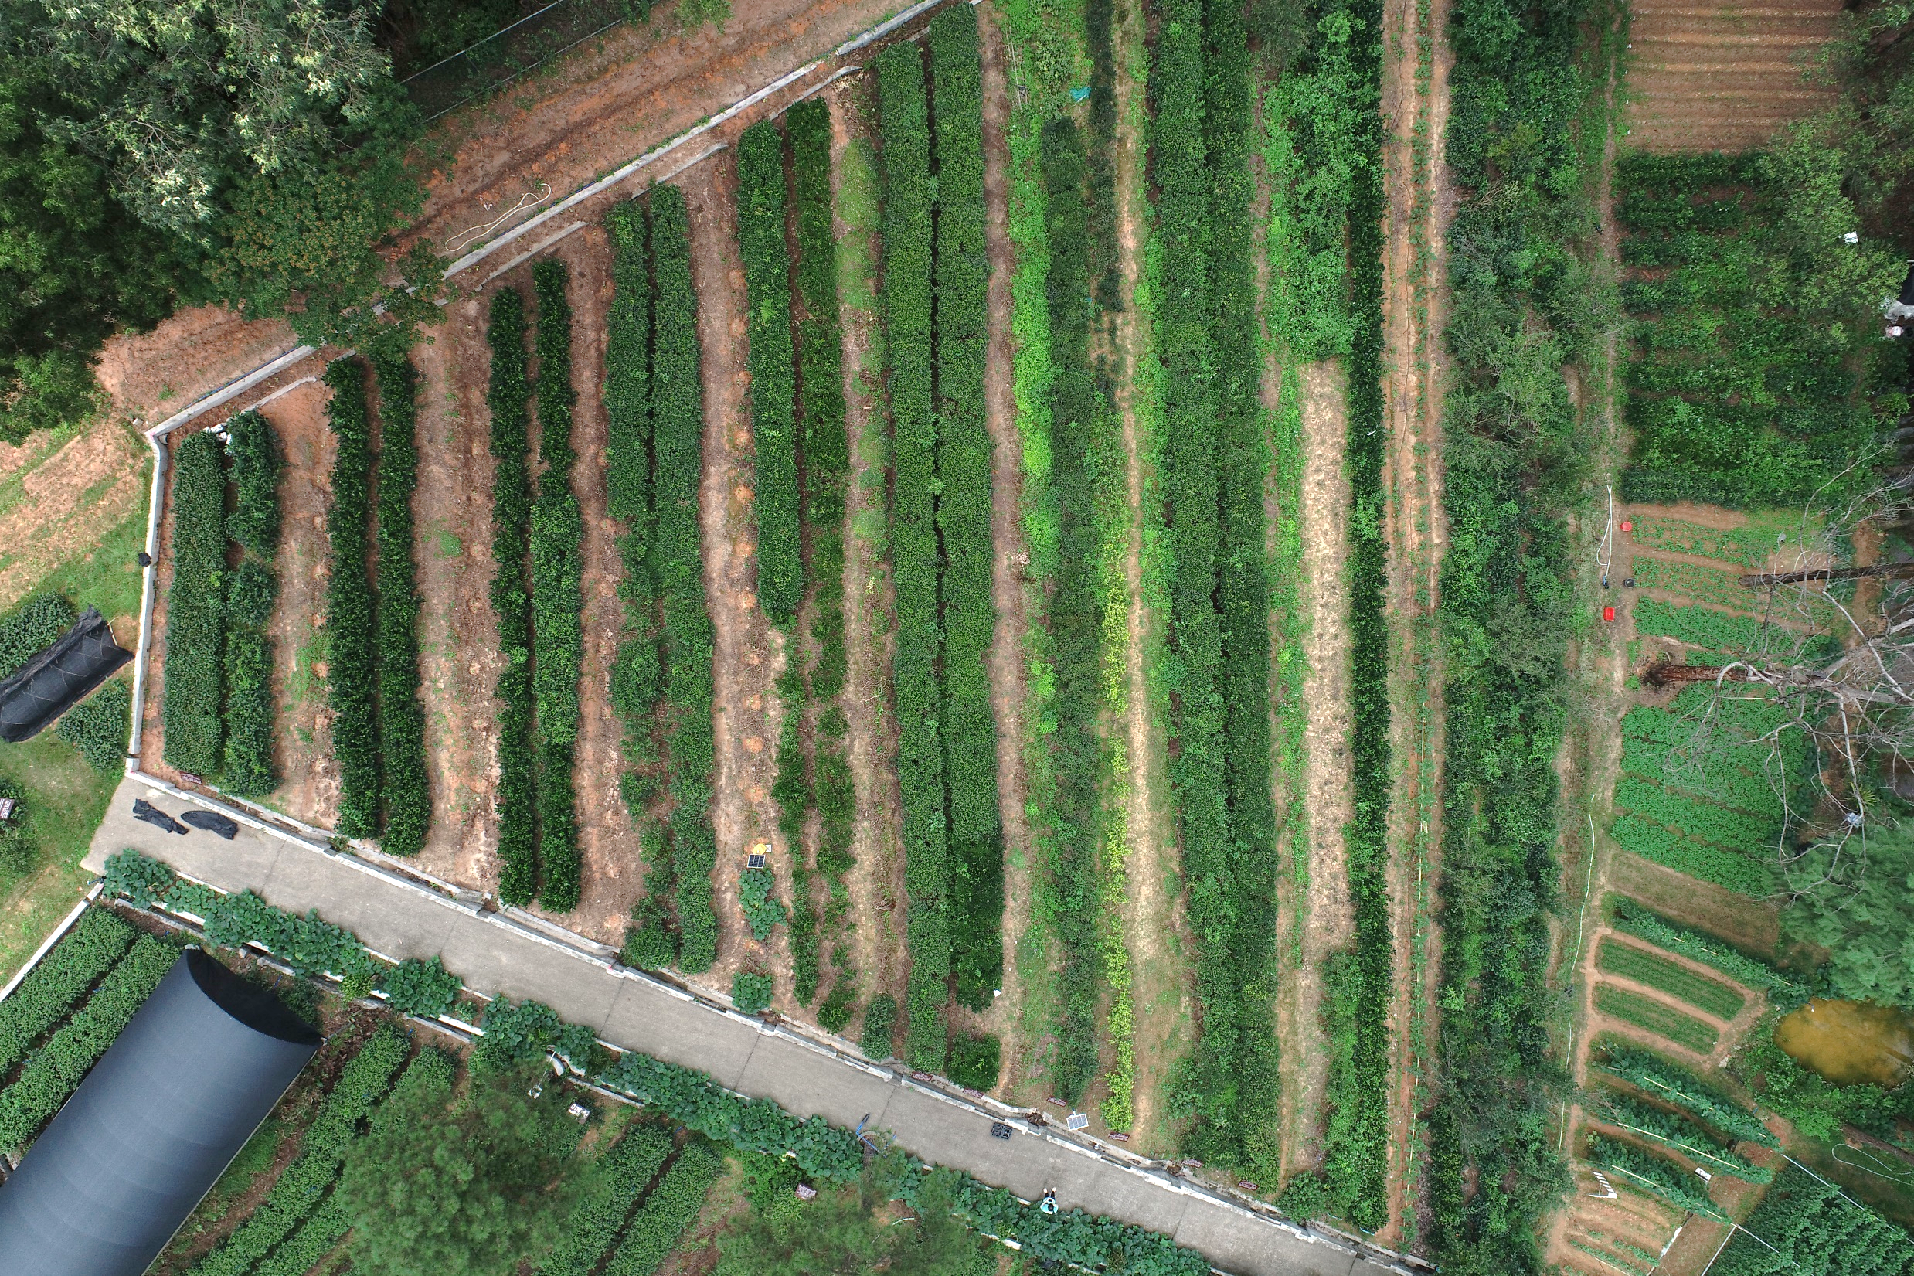
Guangdong Province
Guangzhou City
Hongbing Dancong
Baiye Dancong
Fenghuang Dancong

Slide 2
H
C
H
H
C
H
R
CH₃
H₃C
CH₂
N
N
chl a R = - CH₃
H
Mg
H
chl b R = - CHO
N
N
H₃C
CH₃
H
H
CH₂
H
O
CH₂
CO₂CH₃
CO₂
CH₃
CH₃
CH₃
CH₃
CH₃
CH₃
H₃C
CH₃
CH₃
CH₃
CH₃
CH₃
R₂
OH
HO
O
O
O
OH
N
H
HO
OR₁
OH
NH₂

Slide 3

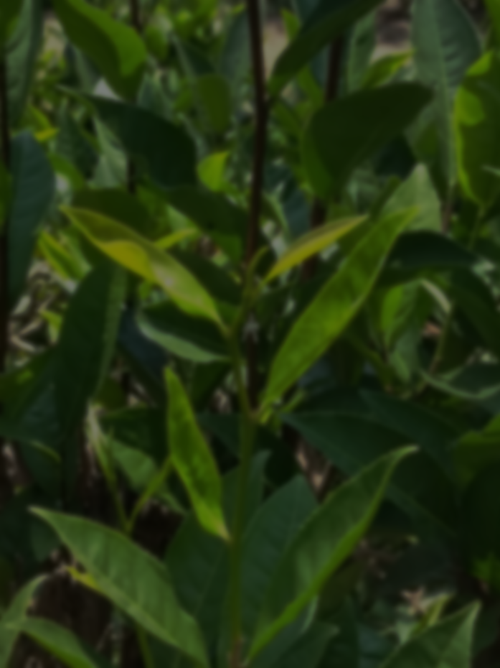

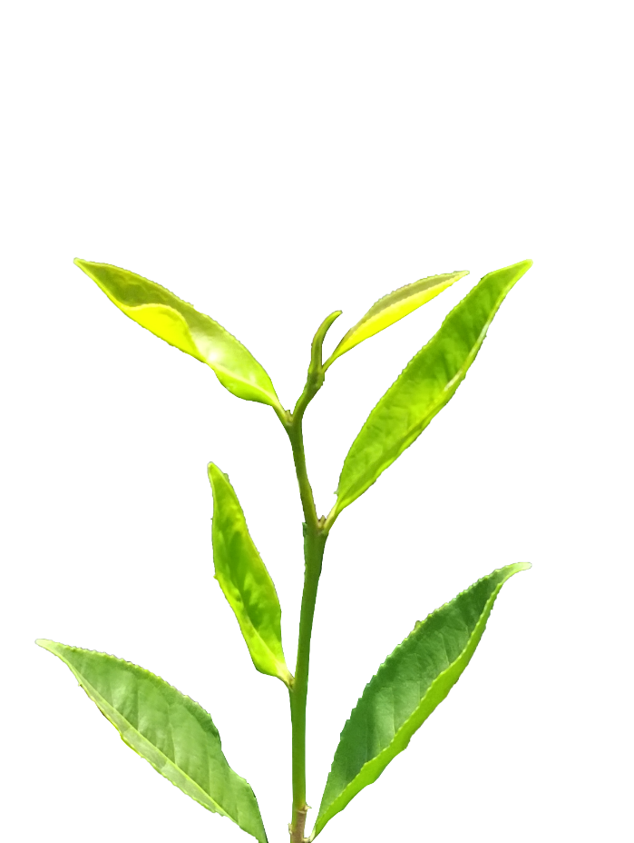

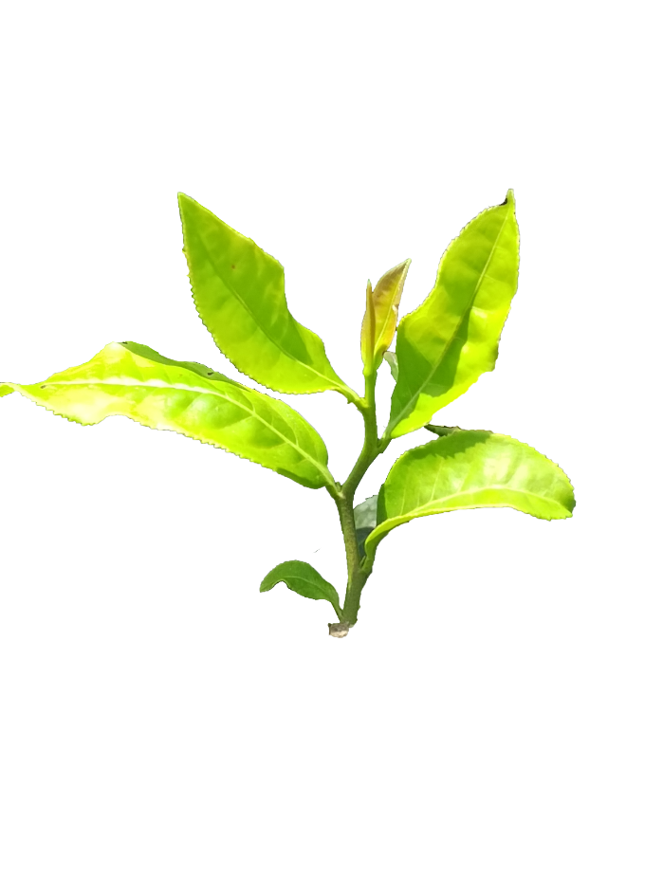
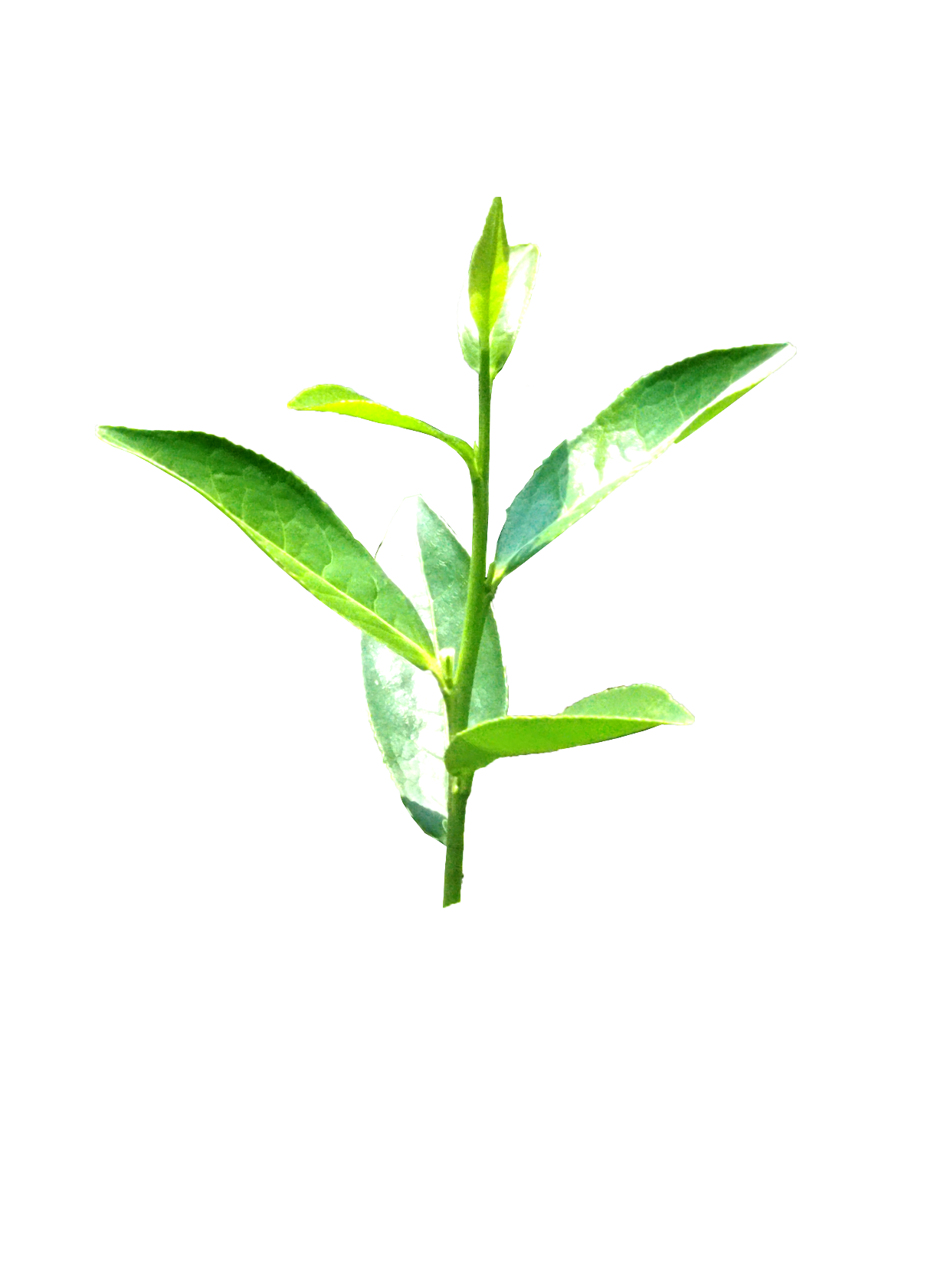

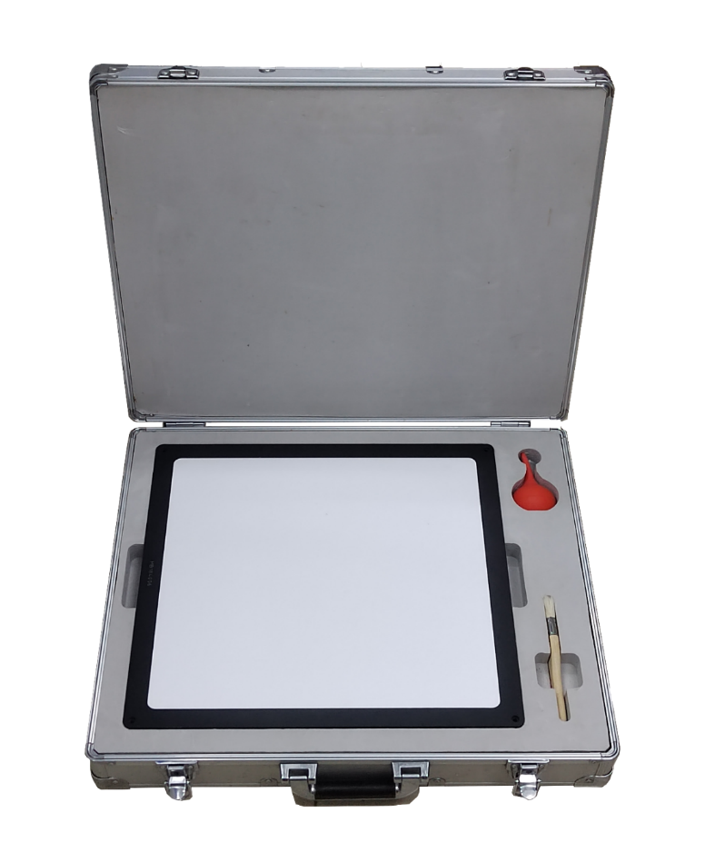

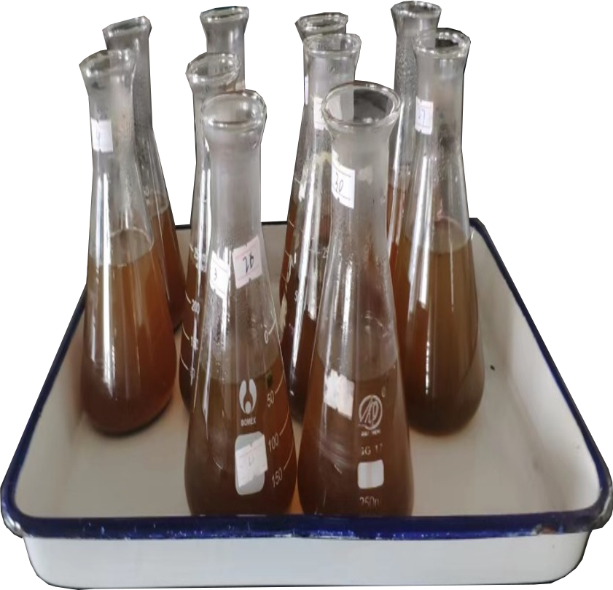
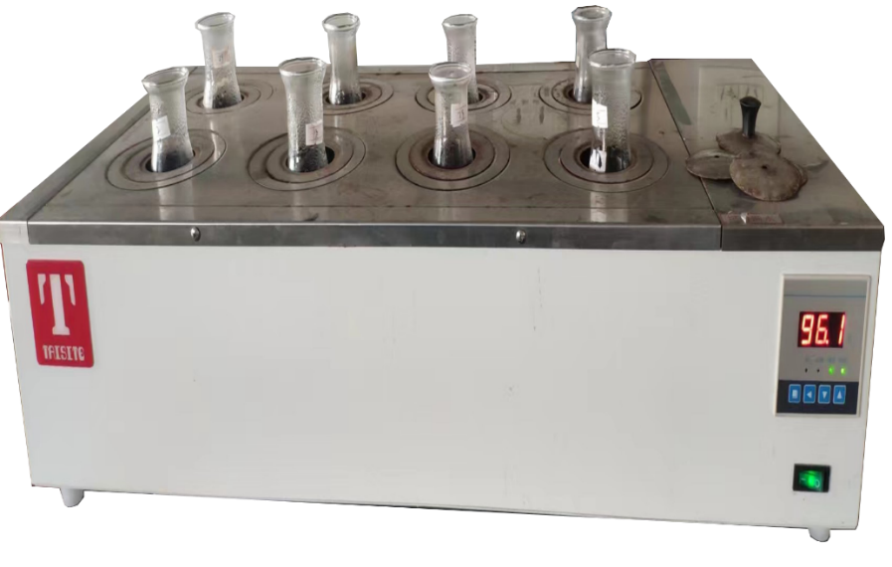
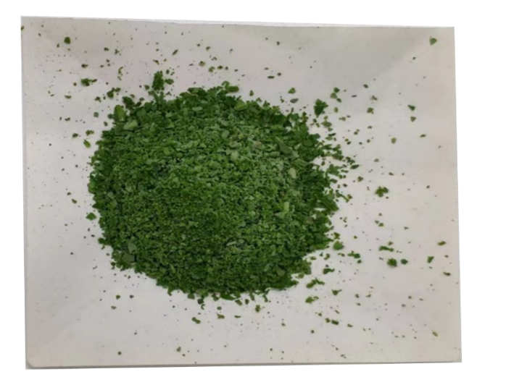
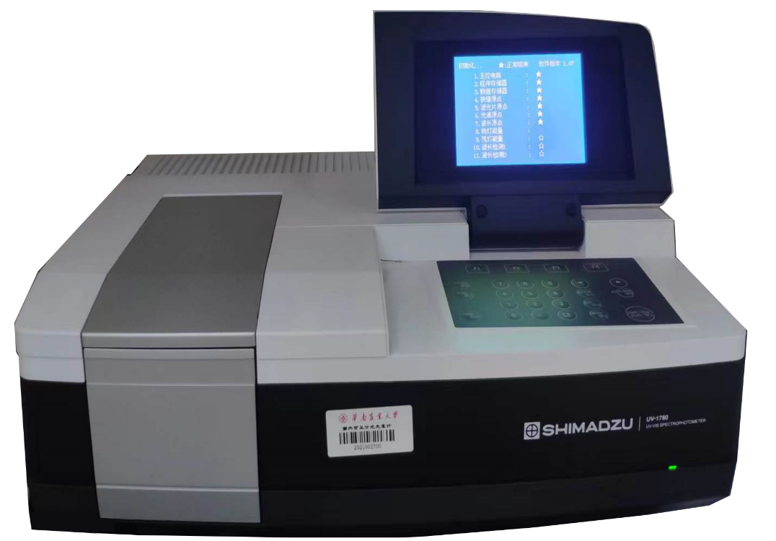
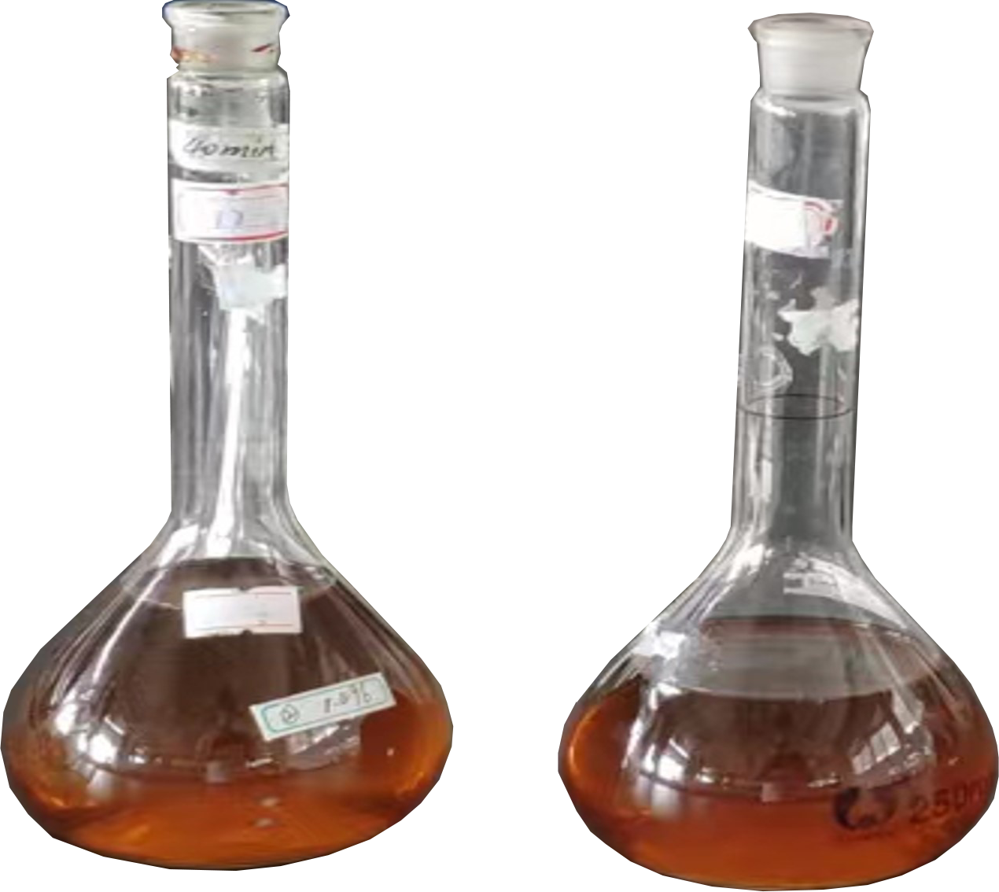
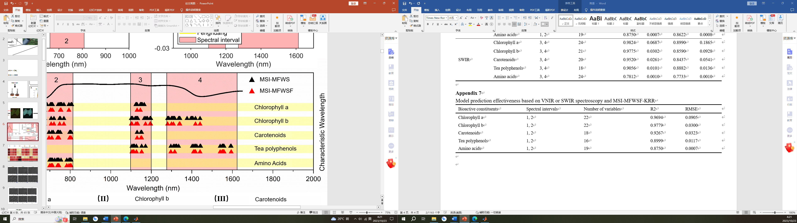
Pigments
extraction
A
①
②
③
Hongbing Dancong
①
Baiye Dancong
②
Fenghuang Dancong
③
Guangdong Province
Guangzhou City
Tea Garden
Experimental plot
B
C
SWIR hyperspectral
camera
Hongbing
Baiye
Fenghuang
VNIR hyperspectral
camera
Sample
Halogen lamp
PTFE standard white board
D
Sample
（Ⅰ）
Black EVA sheet
Grind
Dissolve
Water bath
Hyperspectral image acquisition
E
（Ⅰ）
（Ⅱ）
（Ⅲ）
Detection
Volume
（Ⅱ）
Data analysis
F
Chlorophyll a
Chlorophyll b
Carotenoids
Tea polyphenols
Amino acids
Chlorophyll
Tea polyphenols
Amino Acids
Carotenoids
Chemical content determination
Regression model establishment

Slide 4
RGB
5.40
Chlorophyll a
0
2.10
Chlorophyll b
0
1.20
Carotenoids
LCMA (10⁻³ mg /10⁻⁴ cm2)
0
42.0
Tea polyphenols
0
16.0
Amino Acids
0
HB-1
HB-2
HB-3
BY-1
BY-2
BY-3
FH-1
FH-2
FH-3

Slide 5
A
（Ⅰ）
（Ⅱ）
B
IBS-CARS
IBS-CARS-Fusing
Chlorophyll a
Chlorophyll b
Carotenoids
Feature Wavelengths
Tea polyphenols
Amino Acids
C
（Ⅰ）
（Ⅱ）
Chlorophyll b
（Ⅲ）
Chlorophyll a
Carotenoids
（Ⅳ）
（Ⅴ）
Tea polyphenols
Amino Acids

Slide 6
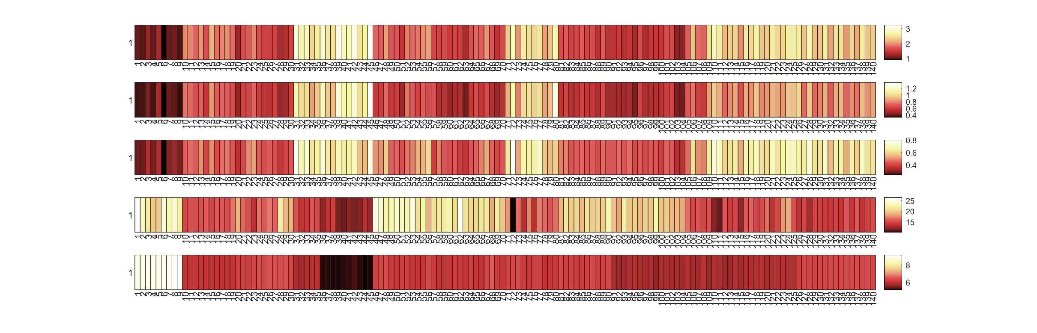
A
30
30
Chlorophyll a
Tea polyphenols
Chlorophyll b
Amino Acids
Carotenoids
HB-1
HB-2
HB-3
BY-1
BY-2
BY-3
FH-1
FH-2
FH-3
B
Chlorophyll a
Chlorophyll b
Carotenoids
Content (%)
Tea polyphenols
Amino Acids
Intervals
HB-1
HB-2
HB-3
BY-1
BY-2
BY-3
FH-1
FH-2
FH-3
Tea Varieties and Leaf Positions

Slide 7
白叶单枞
凤凰单枞
红柄单枞
(a)
(b)
(c)
(d)
(e)
(f)

Slide 8
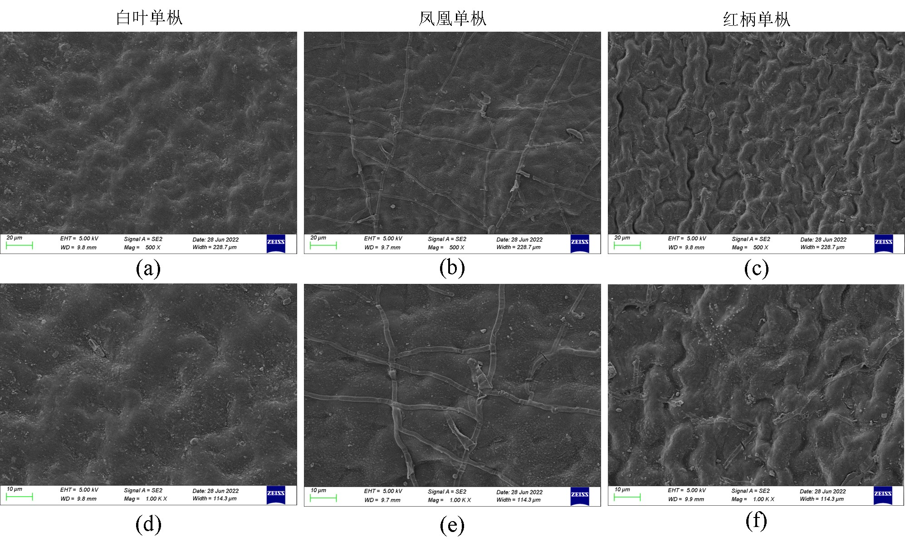

Slide 9
A
（Ⅰ）
（Ⅱ）
（Ⅲ）
HB
FH
BY
B
（Ⅰ）
（Ⅱ）
1000-1030nm
O-H 2nd frequency
1150-1220nm
C-H (CH₃) 2nd frequency
1360-1450nm
Sum frequency: C-H (CH₃) 1st
+C-H (CH₂) 1st & 2nd frequency
1490-1540nm
N-H 1st frequency
450-500nm
Chlorophyll a/b
650-700nm
Chlorophyll a/b

Slide 10
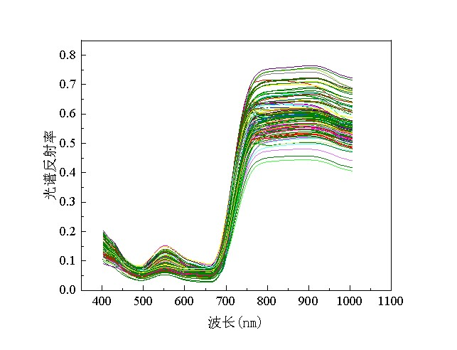
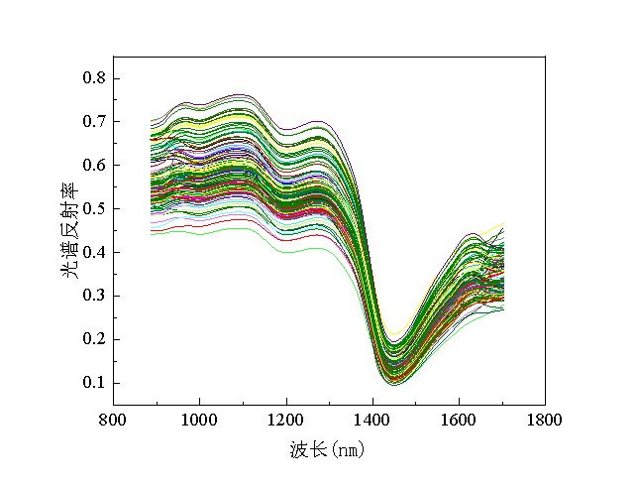
(a)
(b)

Slide 14
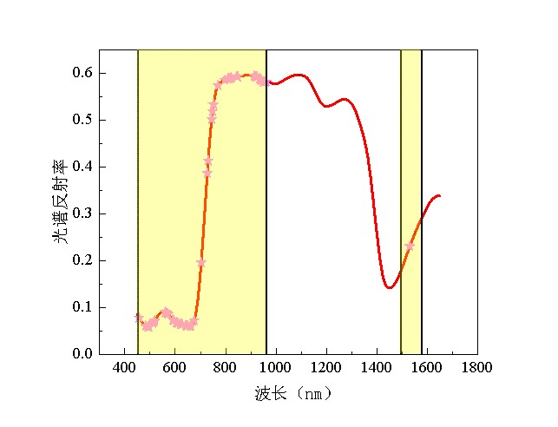
叶绿素a

Slide 15

叶绿素b

Slide 16
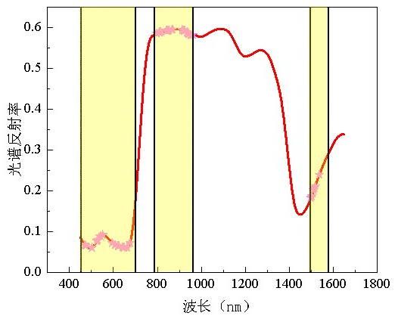
类胡萝卜素

Slide 17
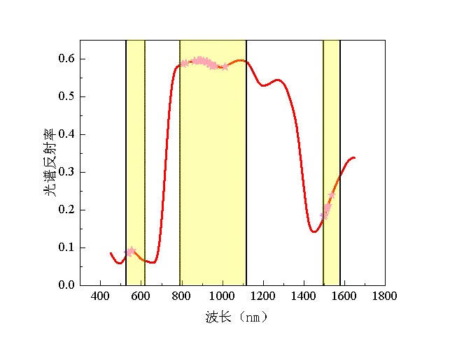
茶多酚

Slide 18
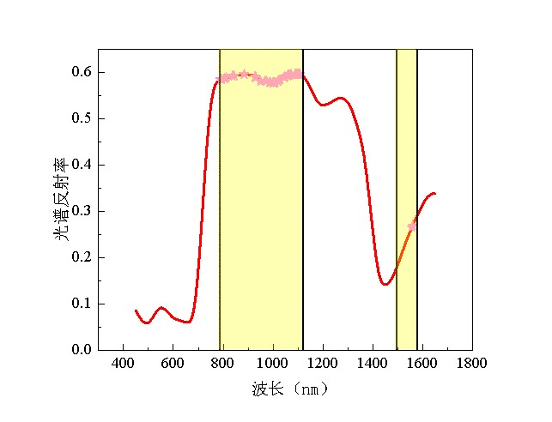
氨基酸

Slide 19
(a)
(b)
(c)

Slide 20
(a)
(b)
(c)
(d)
(e)

Slide 21
(a)
(b)

Slide 22
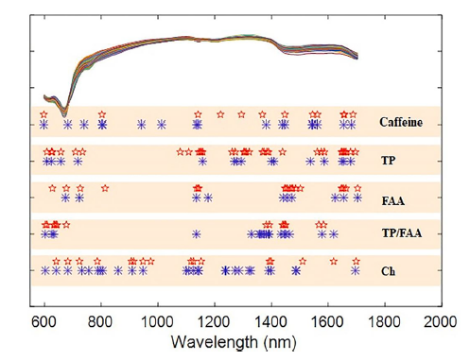

Slide 24
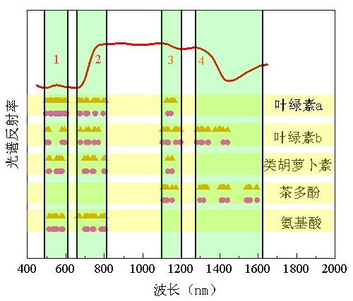

Slide 25
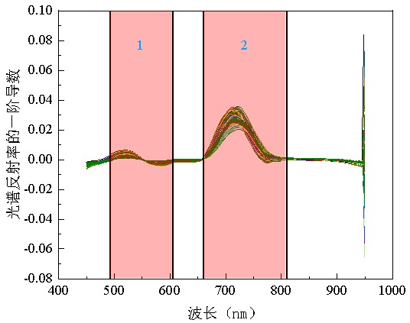
一阶微分

Slide 26
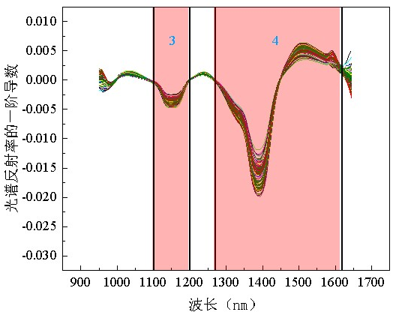

Slide 27
(a)
(b)

Slide 28
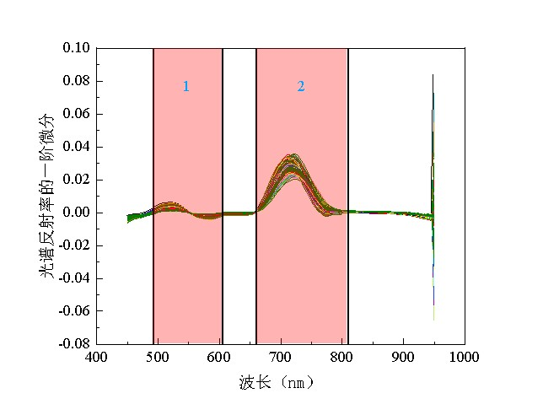
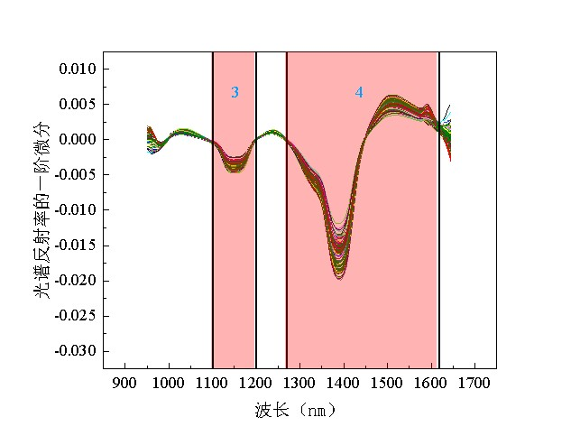
(a)
(b)

Slide 29
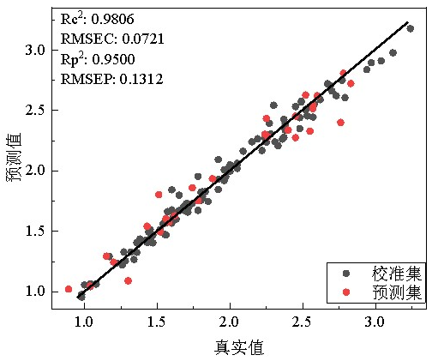
叶绿素a

Slide 30
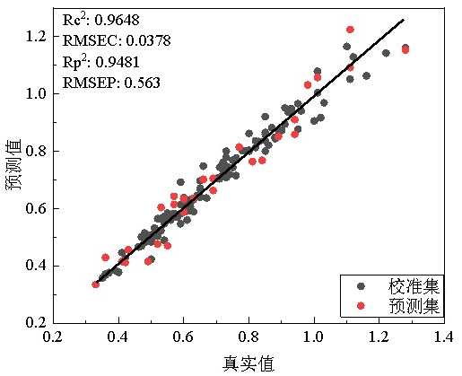
叶绿素b

Slide 31
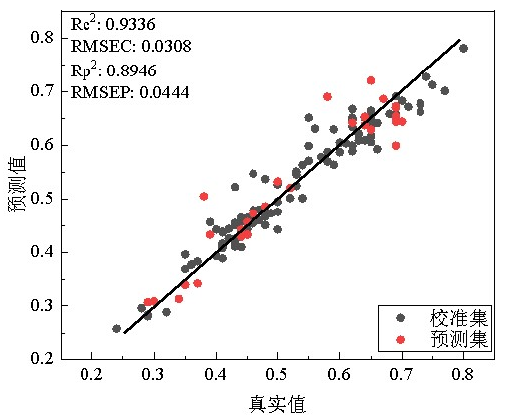
类胡萝卜素

Slide 32
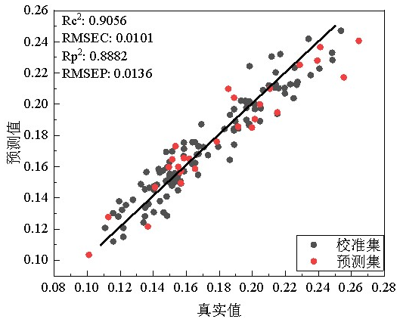
茶多酚

Slide 33
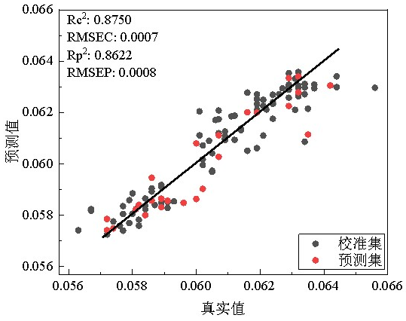
氨基酸

Slide 34
(a)
(b)
(c)
(d)
(e)

Slide 35





(a)
(b)
(c)
(d)
(e)

